Slide 1
3D CAD Editing
With VLMs
Autodesk Problem Overview

Slide 2
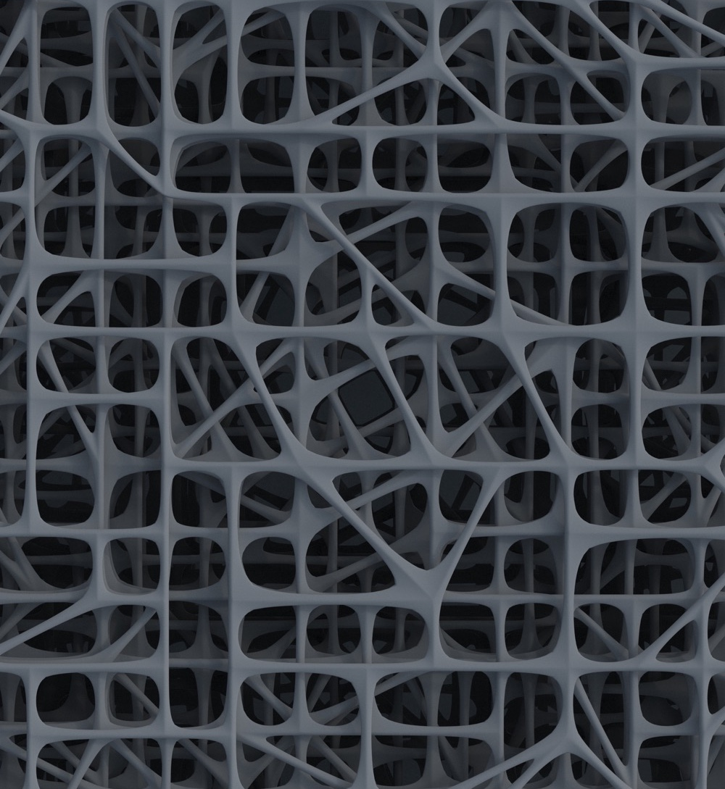
Agenda
01
The Problem
02
Your Goal
03
Overview of the Benchmark
04
Submission Details

Slide 3
The Problem
Editing 3D CAD is hard

Slide 4
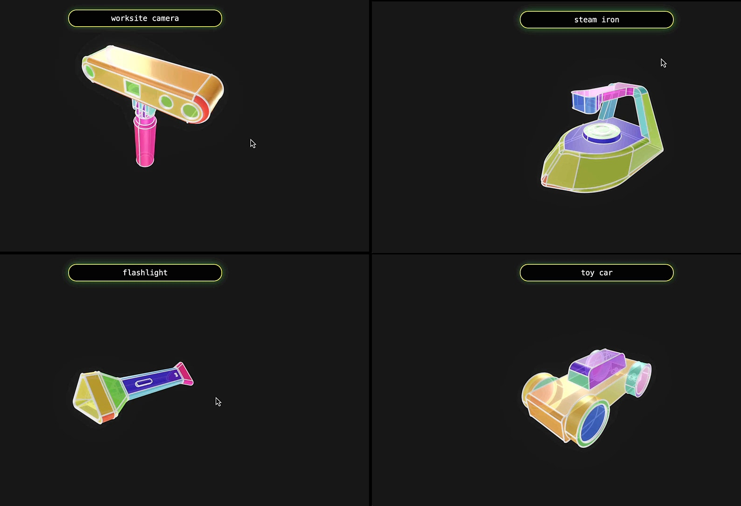
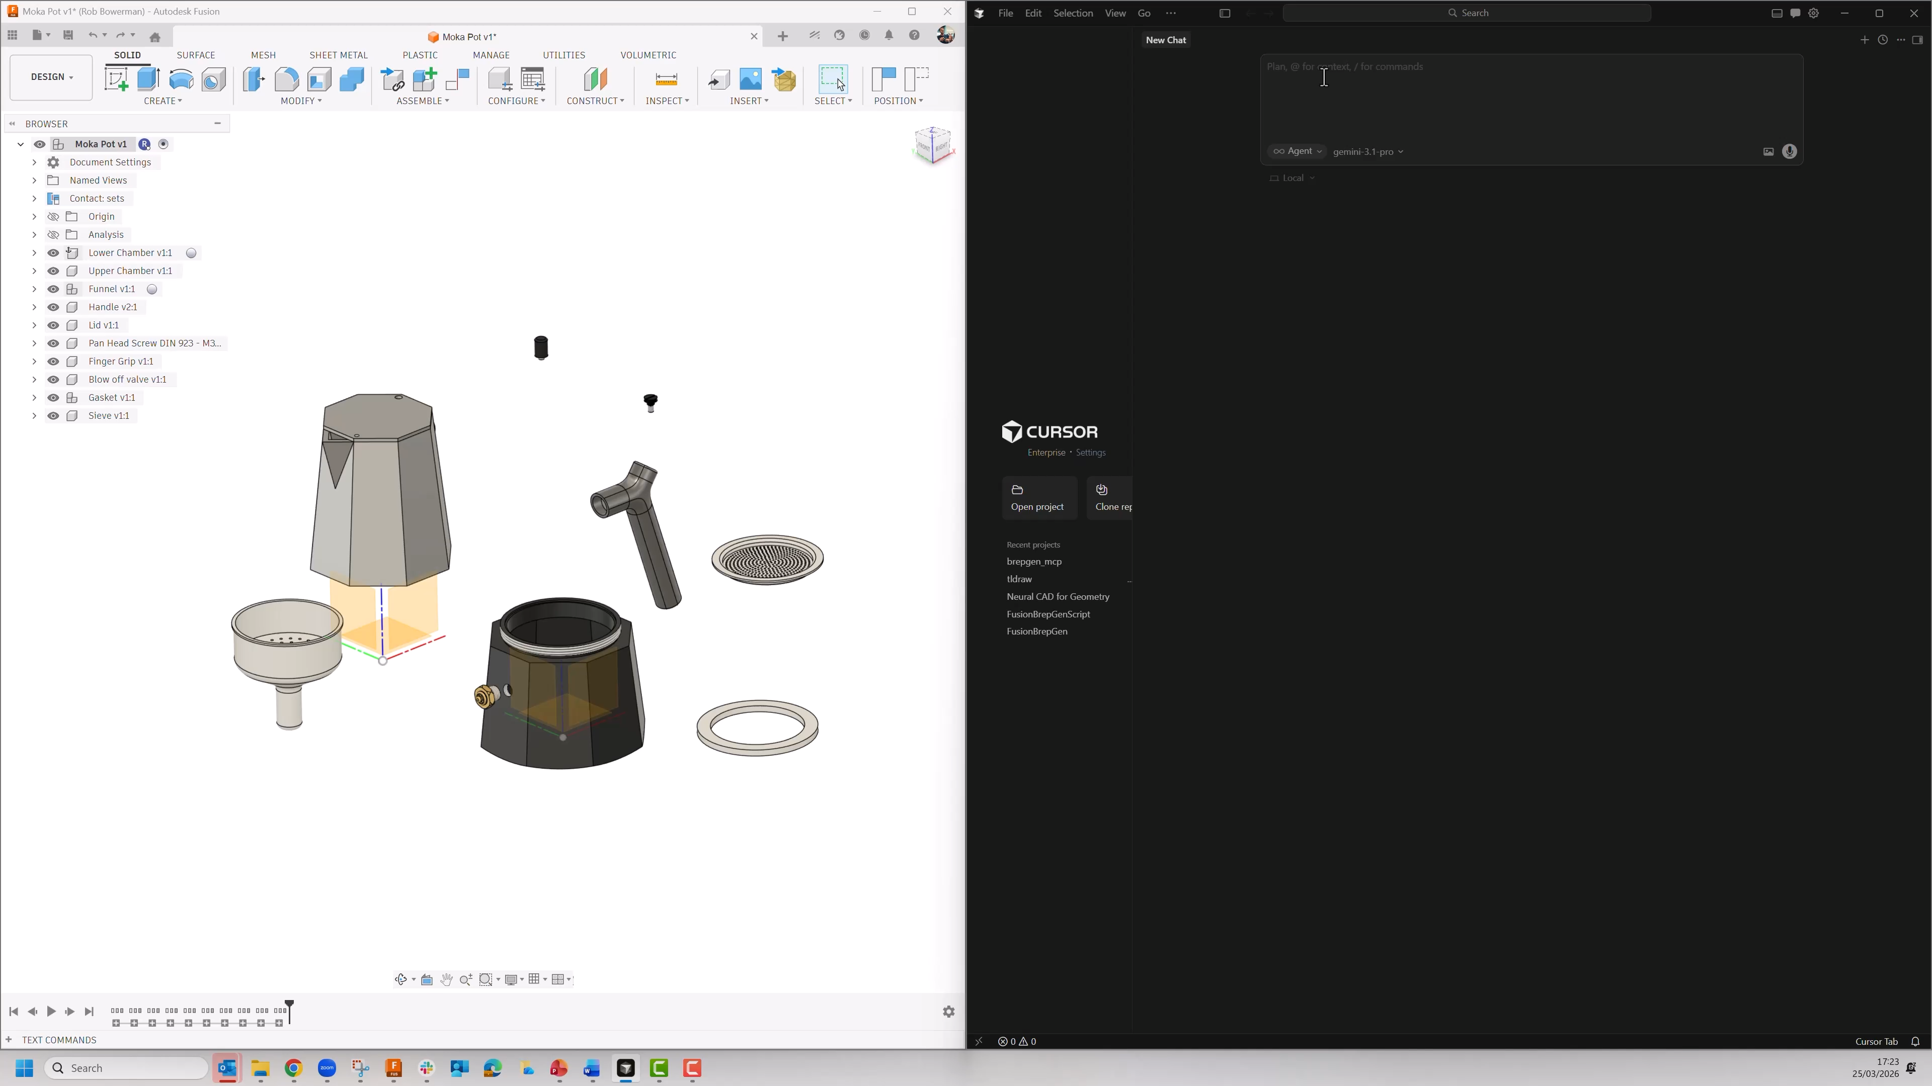
3D CAD generation has progressed rapidly
Autodesk’s neural CAD models
VLMs/ MCP servers
Notes:
AI has recently got a lot better at generating 3D CAD
Be that Autodesk’s own neural CAD models
or VLMs plugged into some CAD interface via MCP (tweets vs adsk mcp)
But here a lot of the focus has been on generating models from scratch, not from editing existing designs.

Slide 5
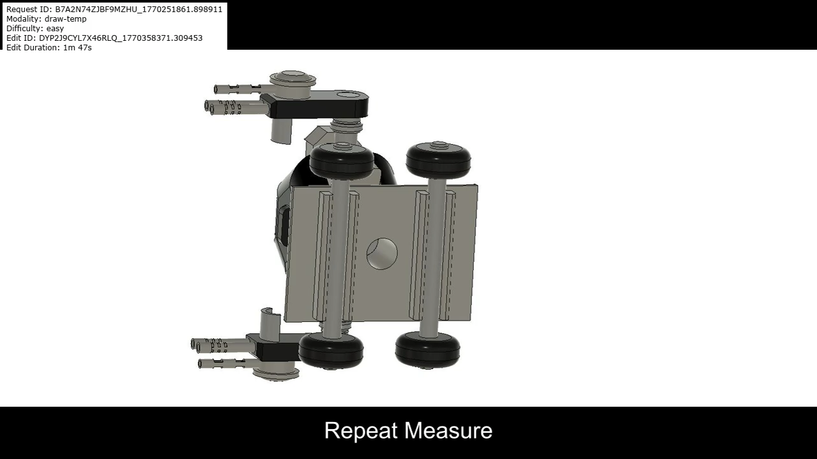
Designers spend more time editing than creating from scratch
Notes:
At Autodesk, Our customers spend a tremendous amount of time editing designs, as opposed to creating them from scratch.
refining models to meet tolerances, incorporating collaborator feedback, updating designs as specifications change, and repairing errors

Slide 6
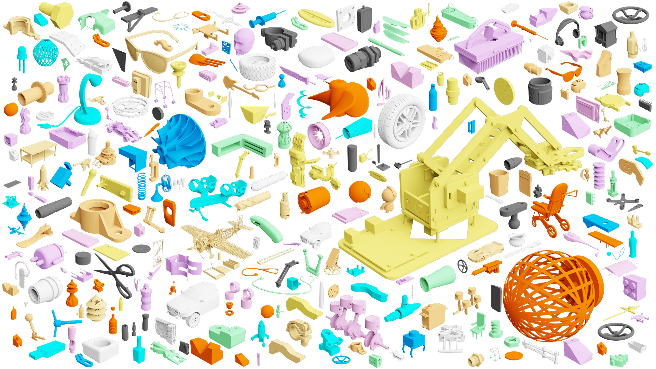
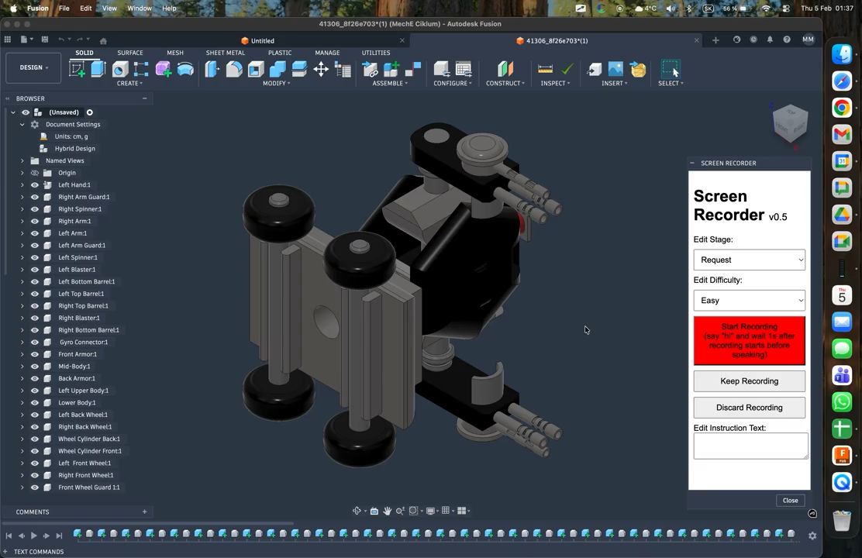
Editing is behind because of data
Datasets contain completed CAD models
rather than edits (differences)
Intent of edits isn’t captured
Fusion Gallery Dataset
Notes:
The big problem here is data.
Whether you’re looking at pre-existing datasets, or customer data, you’re looking at completed CAD models, rather than edits.
The reasons behind a particular change to a model might not be recorded anywhere.

Slide 7

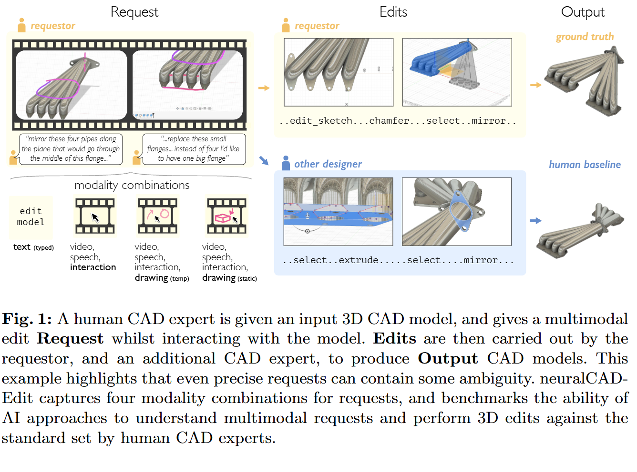
neuralCAD-Edit
An Expert Benchmark for Multimodal-Instructed 3D CAD Model Editing
Notes:
VLMs have the potential to help in speeding up 3D CAD model editing, and in fact Toby and Will released a paper on this topic, where they evaluated several VLMs against a benchmark that the developed.

Slide 8
Your Goal
Design an agentic harness that allows a VLM to edit CAD models in response to text instructions.

Slide 9
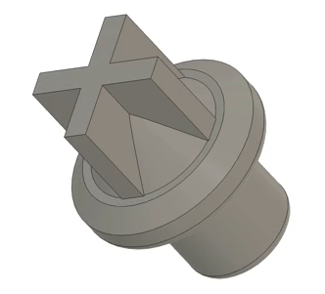
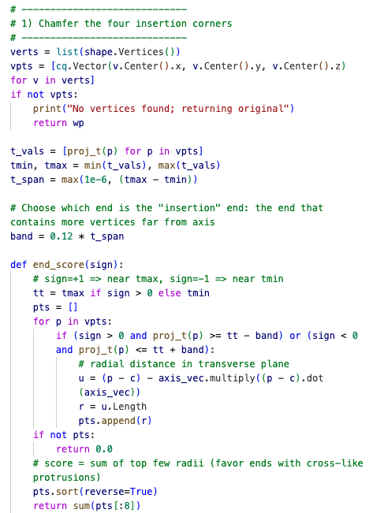
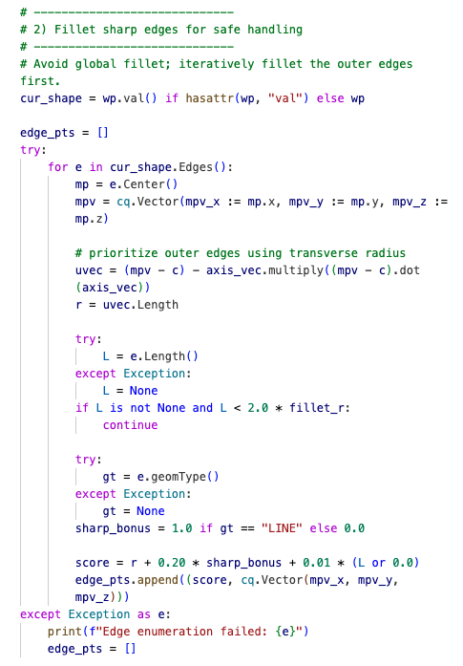
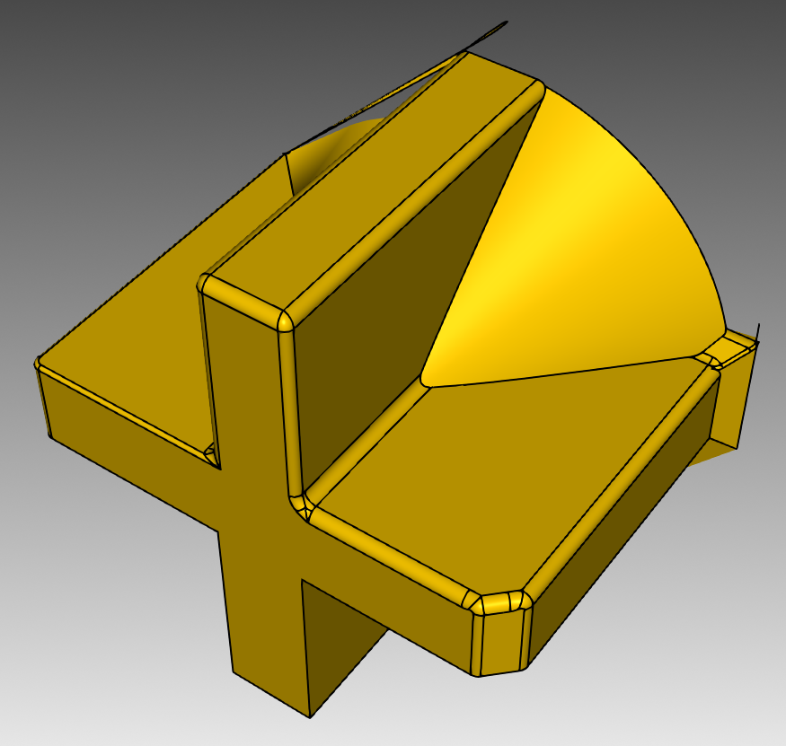
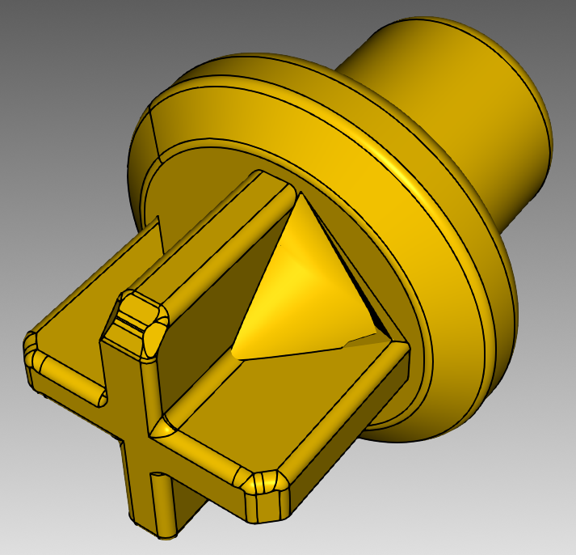
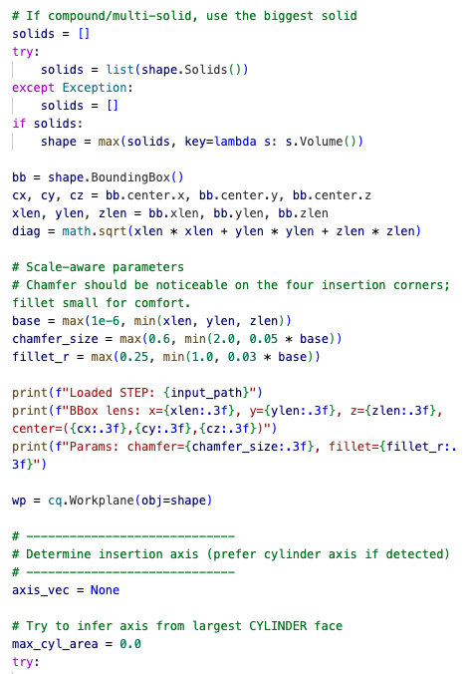
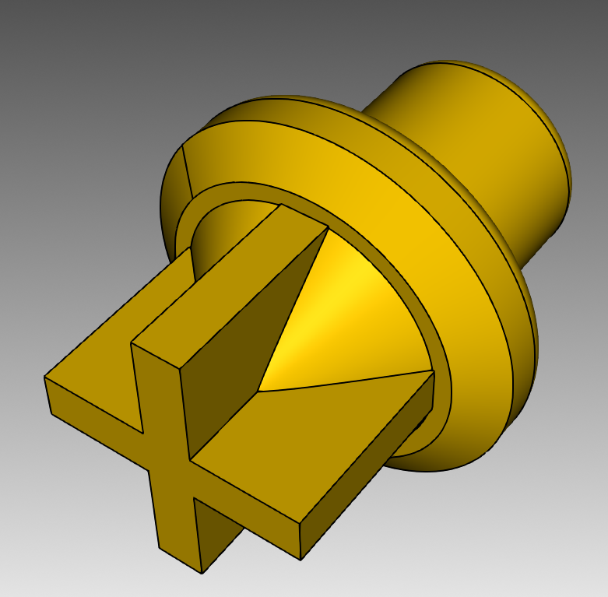
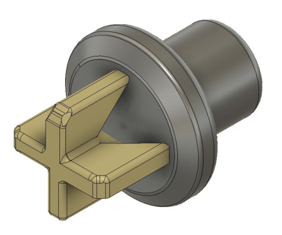


A Simple Harness
Harness
.step
VLM
CadQuery
Add a connecting hole of 1.7 mm diameter and apply 0.1 mm grooves to increase grip and prevent slipping.
.step
.jpg
text

Slide 10
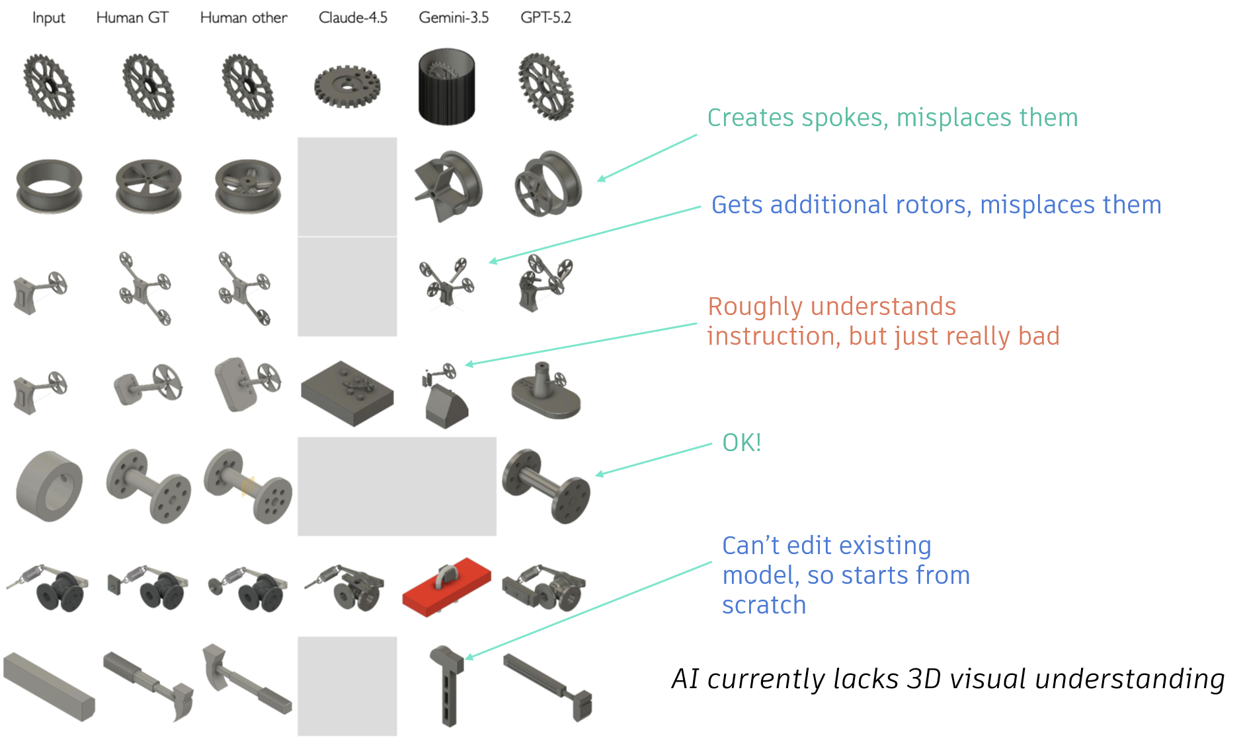
Room for Improvement
Maximize performance on automatic metrics
Pass additional metadata about the CAD model and its current state
Use multiple agents to perform and guide different parts of the edit process
Provide proving tools to the VLM
Improve token efficiency
Reduce the cost of performing edits
Notes:
There are lots of possible reasons why VLMs are bad at this task currently:
Lacks visual understanding
Lacks 3D understanding
Lacks CAD/ engineering knowledge
Model reliability
…
VLMs can’t tell when they’re done
Stop early (and late)

Slide 11
The Benchmark

Slide 12
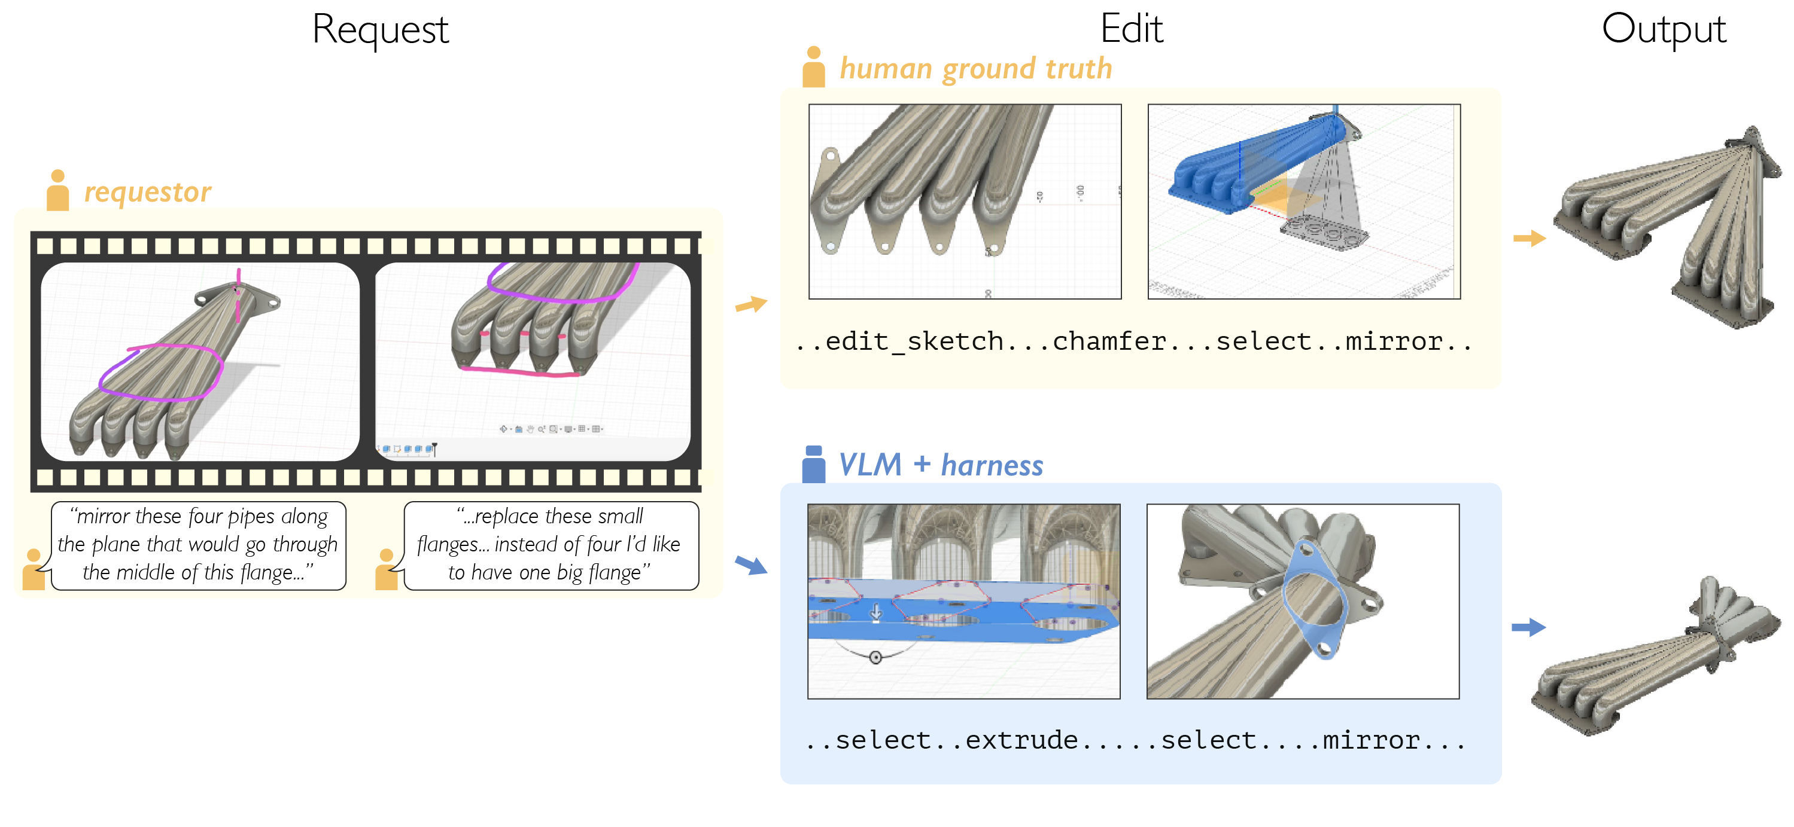
Benchmark
48 edit requests total
  Text-conditioned edits only (not video/drawing)
  Collected from expert designers
  Some assemblies, some single components
  Expected to take human designers between 2 and 10 minutes each
Link for download in repo
3 automatic evaluation scripts
Notes:
The benchmark that you will use is a modified version of the one released with the paper.
It is very important that you use the modified version that you can find in the repo.

Slide 13
Submission Details

Slide 14
Submission Details
Category | Criteria | Score
Quantitative Evaluation (40%) | On all text-conditioned edits (48), computed with provided codebase: **Diff F1** Volumetric F1 Chamfer Similarity | 0-10 points
Qualitative Evaluation (40%) | Method evaluation: Novelty Cost efficiency Scalability Effectiveness | 0-10 points
Other (20%) | Presentation quality, structure, and clarity. Future work and broader impact discussion. | 0-10 points
Code
  Submit your final code as a pull request to our repository
Output CAD files (.step and .stl)
  Include in the repository
Scores (computed by code we provide):
  Surface chamfer similarity,
  Volumetric F1 similarity,
  Volumetric Difference F1 similarity <-- most important!
Final presentation
  Include a PDF of the presentation in your repository
  Include overview of your method, final scores (metric_bar_facets.png), images of the 5 selected test examples for qualitative evaluation on 1 slide
test_example_request_ids = [
'SUJ2G2UMJQR7PMBX_1759209987.785593',
'3YH2WFSRM22W7DKT_1769773335.525203',
'B7A2N74ZJBF9MZHU_1770174133.012106',
'F332D3FXML85WLR2_1769607142.566352',
'ZK22J6VYRKQ2RTFD_1758874422.1403751']

Slide 15




Good luck!
Get started with code and dataset > https://github.com/grndnl/IDETC26-Hackathon-Autodesk-neuralCAD-Edit
William McCarty
Toby
Perret
Daniele Grandi

